Slide 1
Boston NetSuite User Group
2019 Fall Summit
November 7, 2019
Welcome!
Agenda
12:00 – 1:00 p.m. Networking, Expo Center & Registration
1:00 p.m. Welcome
1:00 – 1:30 p.m. Client Spotlights
1:30 – 2:00 p.m. Panel Discussion: Expense Solutions
2:00 – 2:30 p.m. Coffee and Networking Break
2:30 – 3:15 p.m. Real Life Scenarios: Saved Searches
3:15 – 4:00 p.m. Financial Reporting & Year End
4:00 – 4:30 p.m. NS Tip Corner
4:30 p.m. Closing Remarks
4:30 – 6:00 p.m. Cocktail Reception & Expo Center Open

Slide 2
Thank You!
Meet the Board
Mike Kean – Sikich
Stephen Enfield – POS Supply
Ken Phu – Hub Pen Company
Joe Cockriel – LogMeIn
Sean Murphy – Walton Signage
Non-Board Assistance
Lindsey White – Sikich
Elizabeth Keefe – Sikich
Bernard Enciso – Square Works Consulting
Chris Manchester – Sikich
Caroline Kirby-Madden – Zone & Co.
Presenters
Gary Cifatte – Candy.com
Joe Smith – Candy.com
Kristen Balash – FSG
Keith Cruickshank
Jill Quintiliani - AppsAssociates
Owen Karlsson – Zone & Co.
Christina Mendonca – 128 Technology
Joe Cockriel – LogMeIn
Matt Sansone – RSM
Christopher Manchester – Sikich

Slide 3






















Thank you to our Sponsors!

Slide 4
Client Spotlights
Presented by:
Gary Cifatte & Joe Smith from Candy.com
Paul Giese from intheBlk Consulting

Slide 5
About Green Rabbit (Candy.com)
Vision Statement: Green Rabbit’s vision is to be the leading online distributor of candy, snacks and gifts on the internet.
Mission Statement: To work with manufacturers, suppliers and partners across multiple retail channels, introducing candy and snacks to the online marketplace.
Goal: Our goal is to provide the best quality, service and performance for every partner integration.

Slide 6
History with NetSuite and Modules Used
Migrated from Excel and manual process to NetSuite in 2011
Utilize as both OMS and ERP
Setup Boomi in 2015, live in 2016
Partner Center used to keep customers up to date and give reporting
Modules used:
Finance
Purchasing
Payables
Order Management
Work Orders and Assemblies
Inventory Management (but not WMS)

Slide 7
Third Party Applications/Integrations
Boomi – EDI order processing
Magento integration – backend to Candy.com
OzLink – shipping software
RDS/Numina WMS (communicates via Restlets/Saved Searches)
RF Smart – pick, pack and ship; replenishment and receiving
Ship Junction – micro fulfillment centers
Ship Station – 3rd party drop ship fulfillments

Slide 8
Customizations/Workflows/Scripts
Ice and Shipping Logic – Scheduled Script
Sales Order Auto Invoicing – Scheduled Script
Invoicing Logic to populate Item Fulfillments custom field
SSCC18 label creation and Check Digit Algorithm
Numerous scripts and a few workflows

Slide 9
Panel Discussion:
Expense Solutions
Presented by: Kristen Balash, Keith Cruickshank & Jill Quintiliani

Slide 10

Networking Break
2:00 – 2:30
Visit Our Sponsors!

Slide 11
Real Life Scenerio:
Saved Searches
Presented by: Owen Karlsson

Slide 12
Searches
Introduction to Searches
Summary Searches
Inline Editing
Formulas

Slide 13
Intro to Searches
Criteria & Results
Saved Search vs. Search
Using Highlighting
Filtering
Emailing

Slide 14
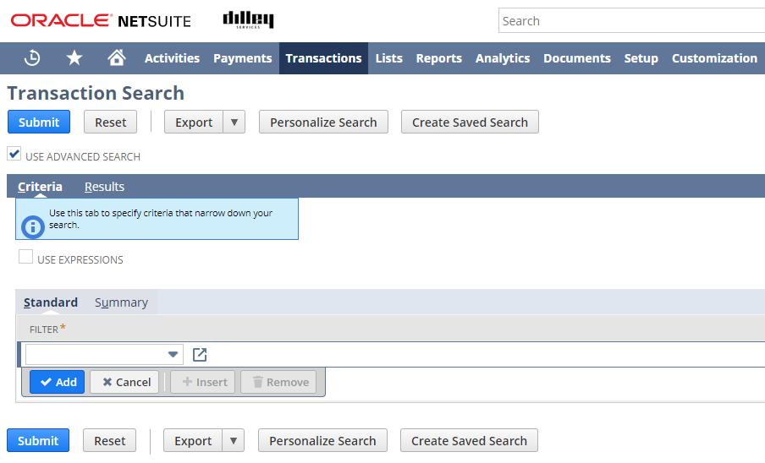
Criteria
The criteria tab controls what data will be returned when the search is run

Slide 15
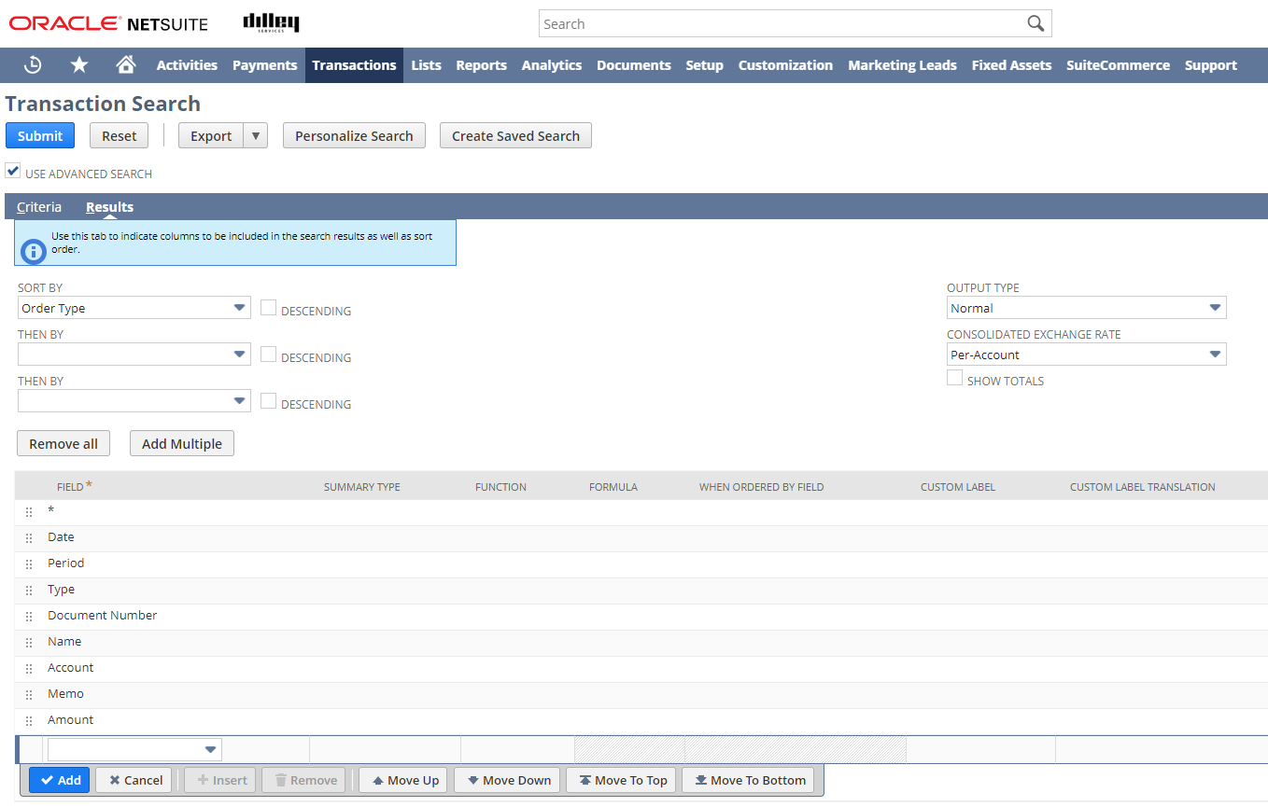
Results
The results tab controls what data columns will be returned when the search is run

Slide 16
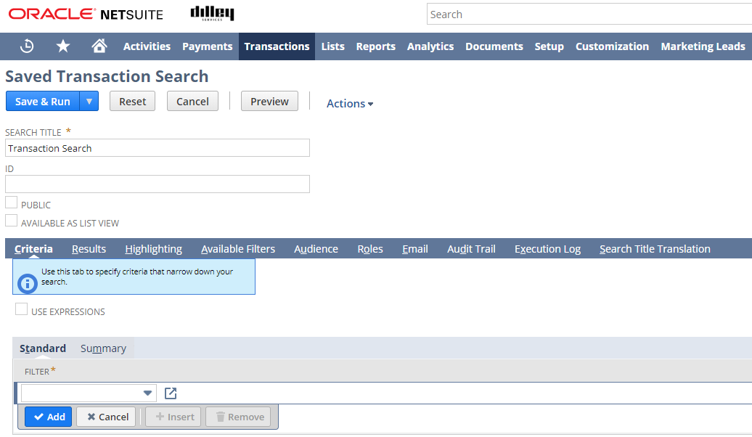
Regular Search vs. Saved Search
Saved Searches allow you additional functionality around Highlighting, Filtering and Emailing functionality

Slide 17
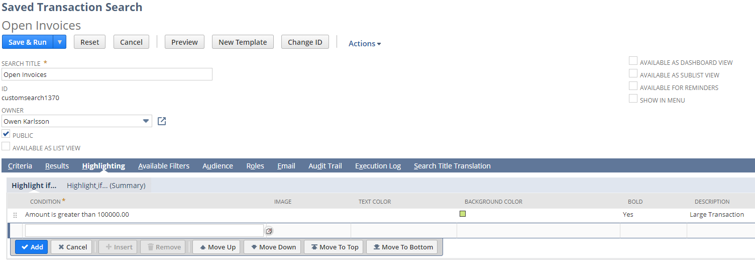
Highlighting
Highlighting allows you to call visual attention to results that fit a certain criteria.

Slide 18
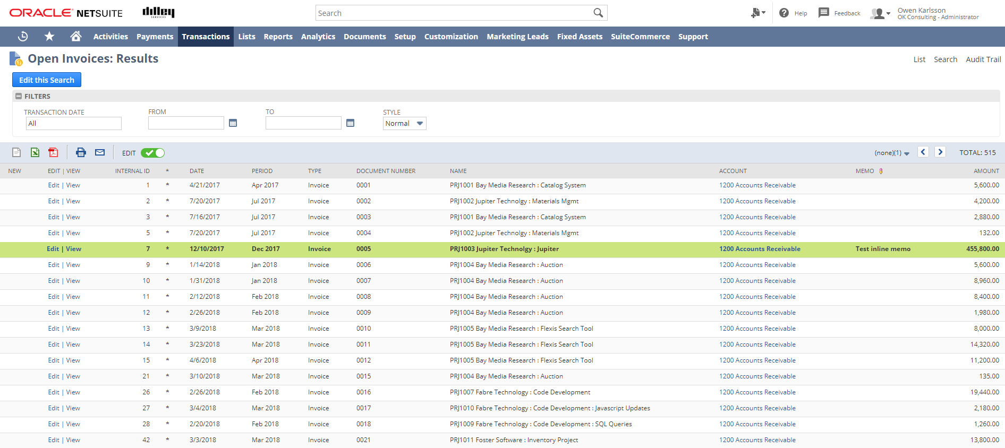
Highlighting Example
Sample of Highlighting for transactions over 100k.

Slide 19
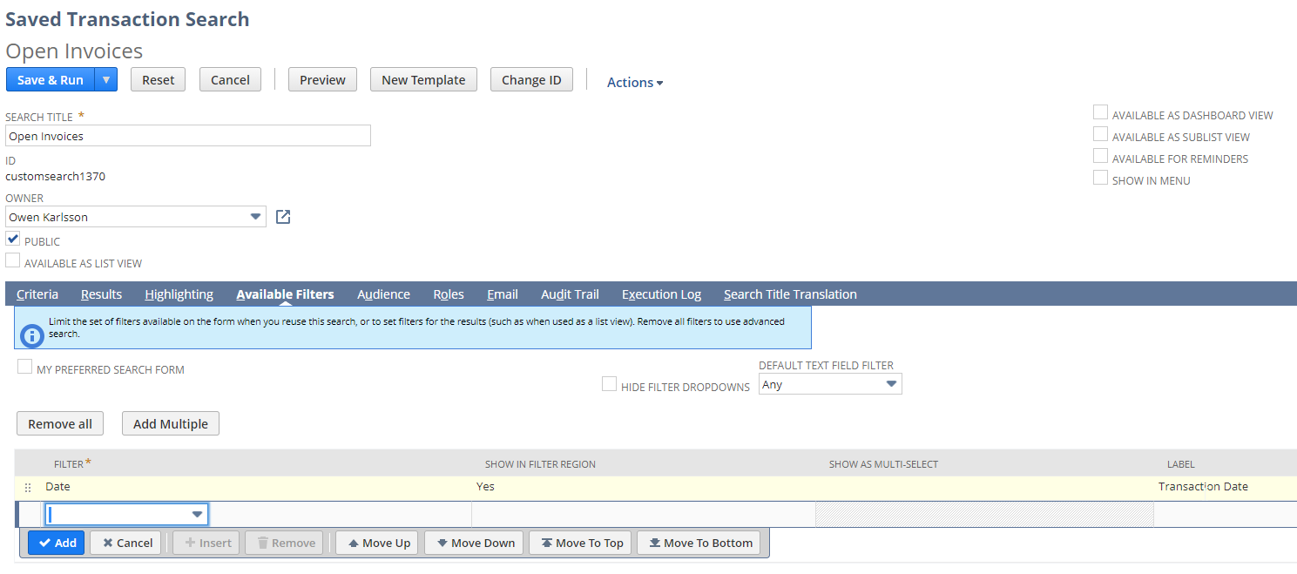
Filters
Filters allow you to apply additional criteria after the search has been executed to allow you to narrow your results beyond the original criteria.

Slide 20
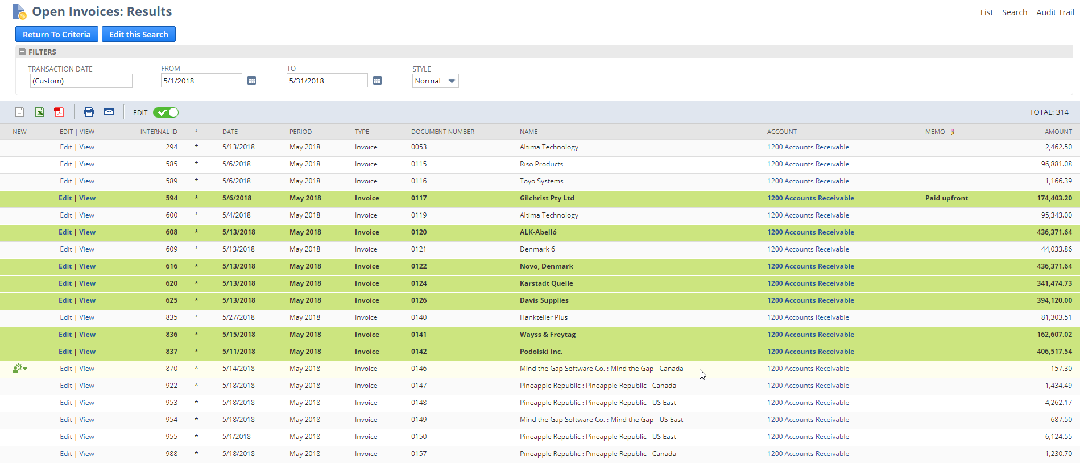
Sample Filtering w/Highlighting
In the filters section, we can further restrict the results, in this case, Open Invoices in May 2018

Slide 21
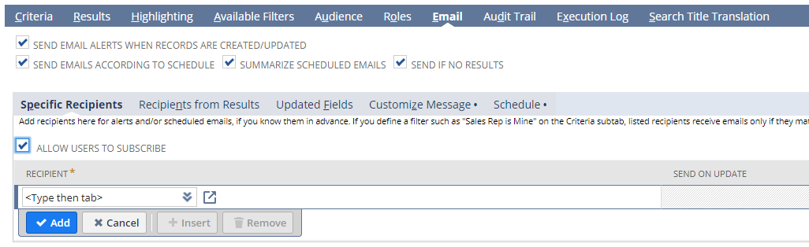
Emailing Saved Searches
You can set up a saved search for emailing capabilities
You can specify recipients as well as allow additional users to subscribe to the search

Slide 22
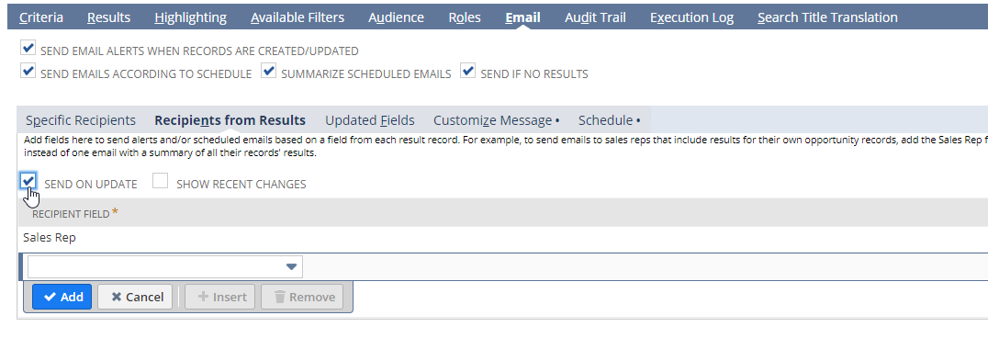
Recipients from Results
You can also specify recipients from fields on the record

Slide 23
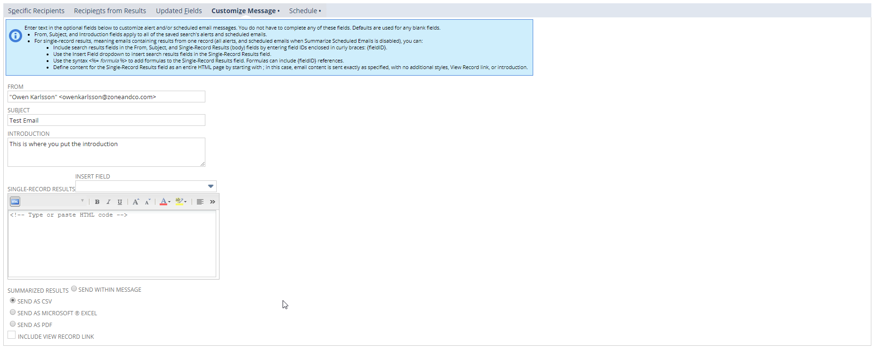
Customizing the Email Message
Sender, Subject and Introduction
Summarized or Single result
File Format (optional)

Slide 24
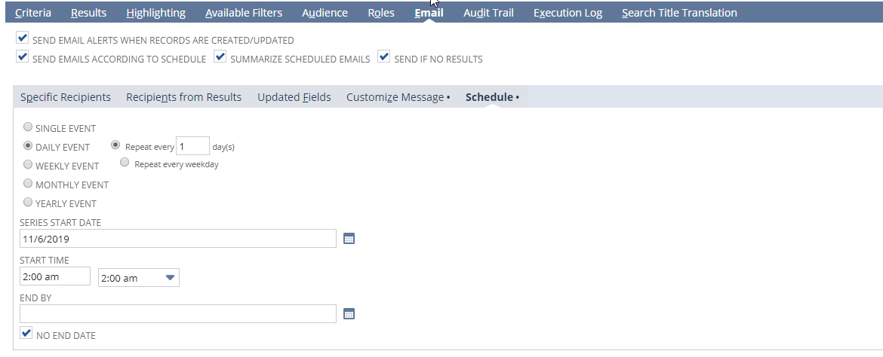
Scheduling the Email
Define the cadence in which the saved search will execute

Slide 25
Summary Searches
Intro to Summary Searches
Summary Types
Summary Criteria
Summary Highlighting
Using the Function column
When Ordered By

Slide 26
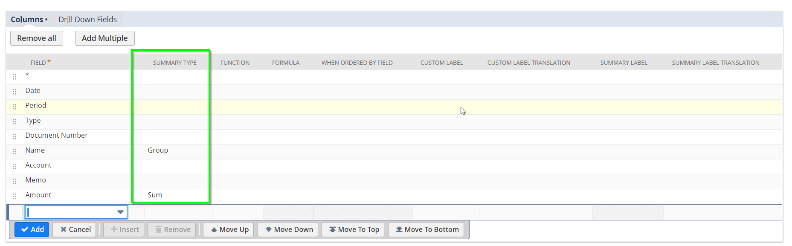
Intro Summary Searches
You can use Summary Type to summarize the results into “Groupings”
The more fields you group by, the more result rows will be returned.

Slide 27
Summary Types
Group – 1 Result row for each unique value in results
Count – Count the unique values found in a Grouping
Sum – Adds up the values in a Grouping (can only apply to Numeric fields)
Minimum – Returns the smallest value in the Grouping (First Alphabetically)
Maximum – Returns the largest value in the Grouping (Last Alphabetically)
Average – Returns the average of the values in the grouping (Numeric Only)

Slide 28
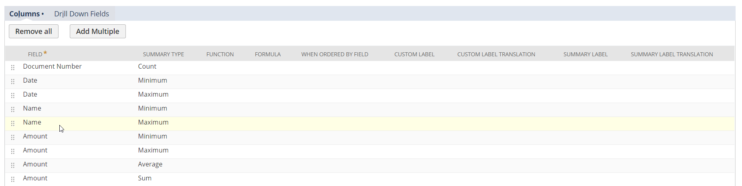
Summary Type Examples
Below is an example of the different applications of Summary Type in a saved search
With No Grouping selected, we will only return a single row of results.

Slide 29
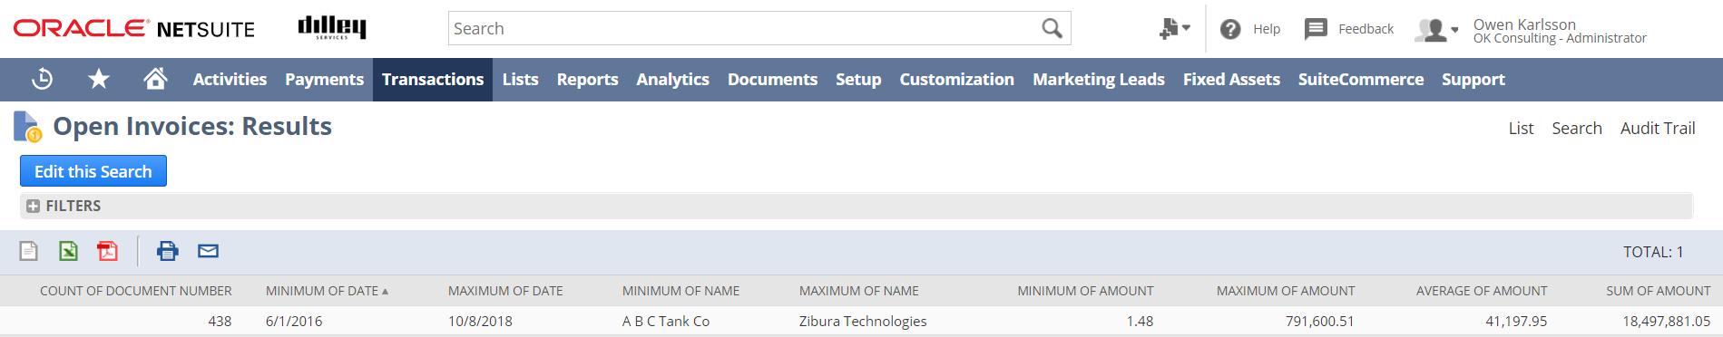
Sample Summary Search
The below shows the application of various Summary Types to some native fields
NetSuite will append Summary Type to the Field Name (If not otherwise specified)

Slide 30
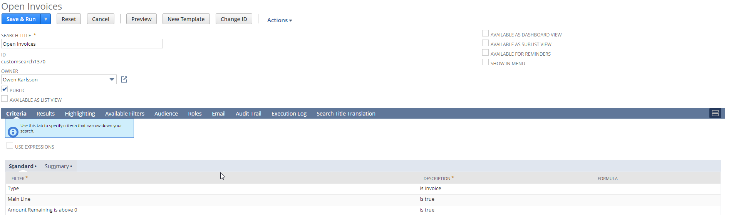
Using Summary Criteria
Summary Criteria is used to restrict the results you’re getting from a Summary Search
If you’re not leveraging Summary Results, Summary Criteria is irrelevant

Slide 31
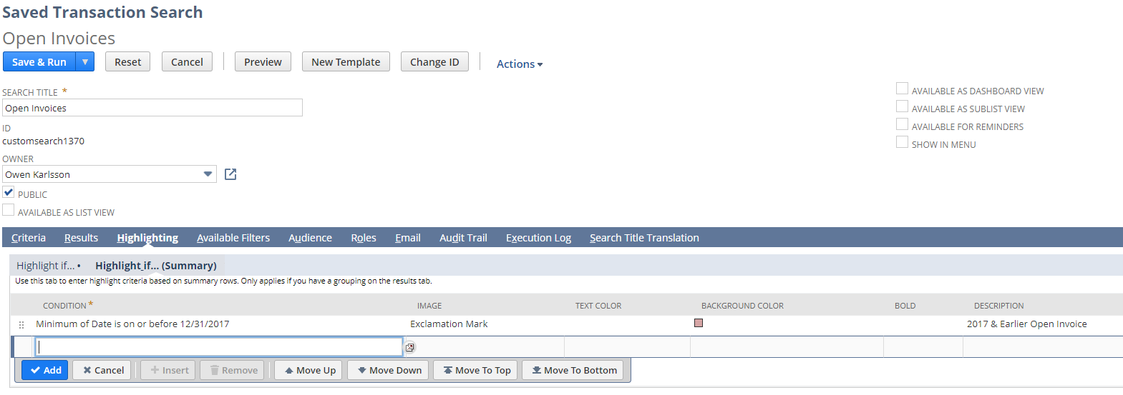
Using Summary Highlighting
Highlight If (Summary) is highlighting for Summary Results.
You can have different highlighting for Summary and Detail.
This example highlights rows that have old (2017&Earlier) open invoices.

Slide 32
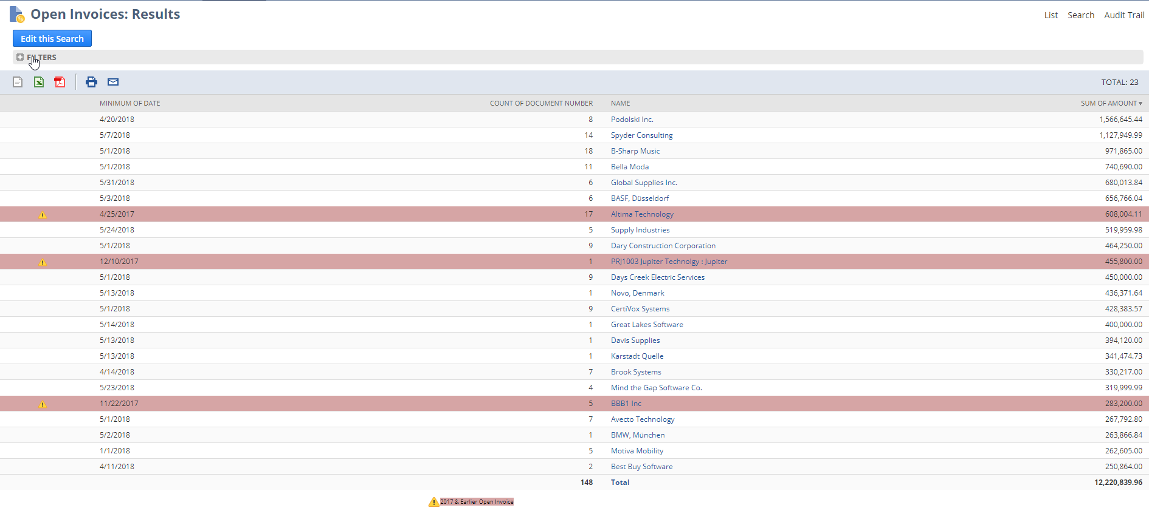
Sample Summary Results
Here is a sample of summary results, including Summary Criteria (Sum of Amount > $250k AND Summary Highlighting for Minimum Date is on or before 12/31/2017)

Slide 33
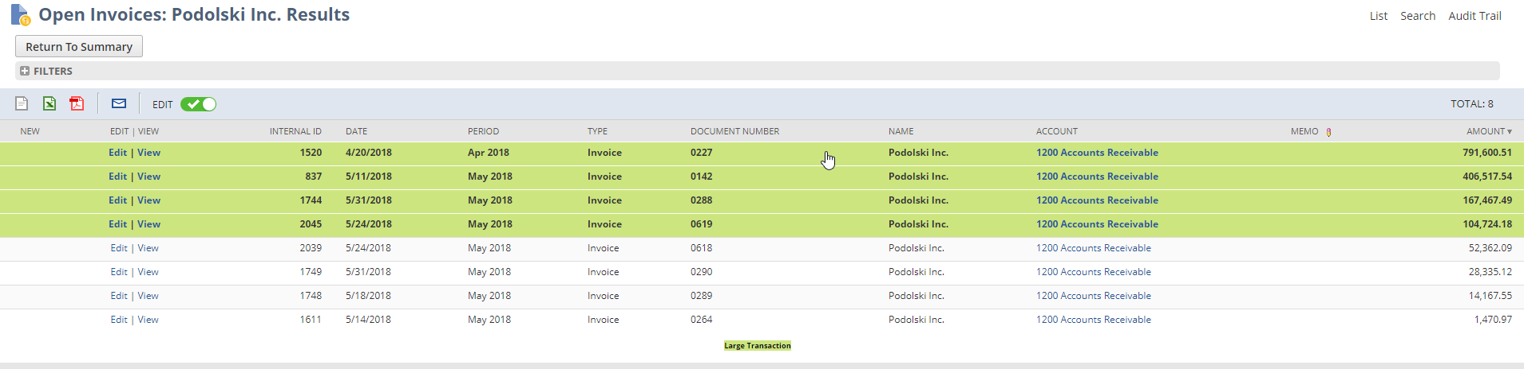
Detailed Results (Drill-down)
When in a summary search, you can click on any field which is “Grouped” and see the detailed search results for that grouping.
The detailed results will maintain the standard Highlighting.

Slide 34
Functions
Functions can be used at both a Detailed and Summary Level
Functions are designed to work in tandem with Numeric or Date values
Numeric Functions: % of Total, Absolute Value, Negate, Rank, Round (1, .1, .01)
Date Functions: Age in [Hours, Days, Weeks, Months, Years], Day, Calendar Week, Week of Year, Month, Quarter, Year

Slide 35
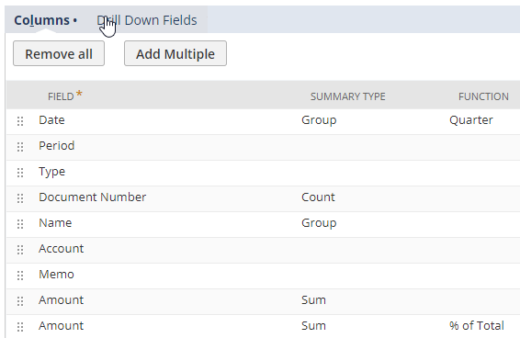
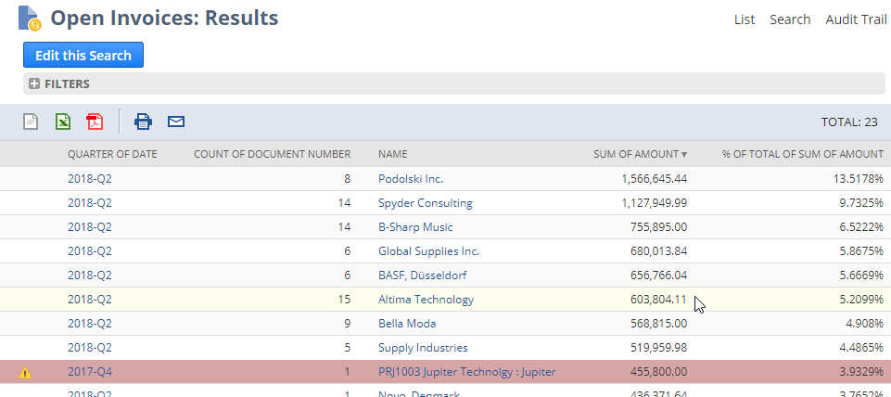
Sample Results using Functions
Numeric Functions: % of Total, Absolute Value, Negate, Rank, Round (1, .1, .01)
Date Functions: Age in [Hours, Days, Weeks, Months, Years], Day, Calendar Week, Week of Year, Month, Quarter, Year

Slide 36
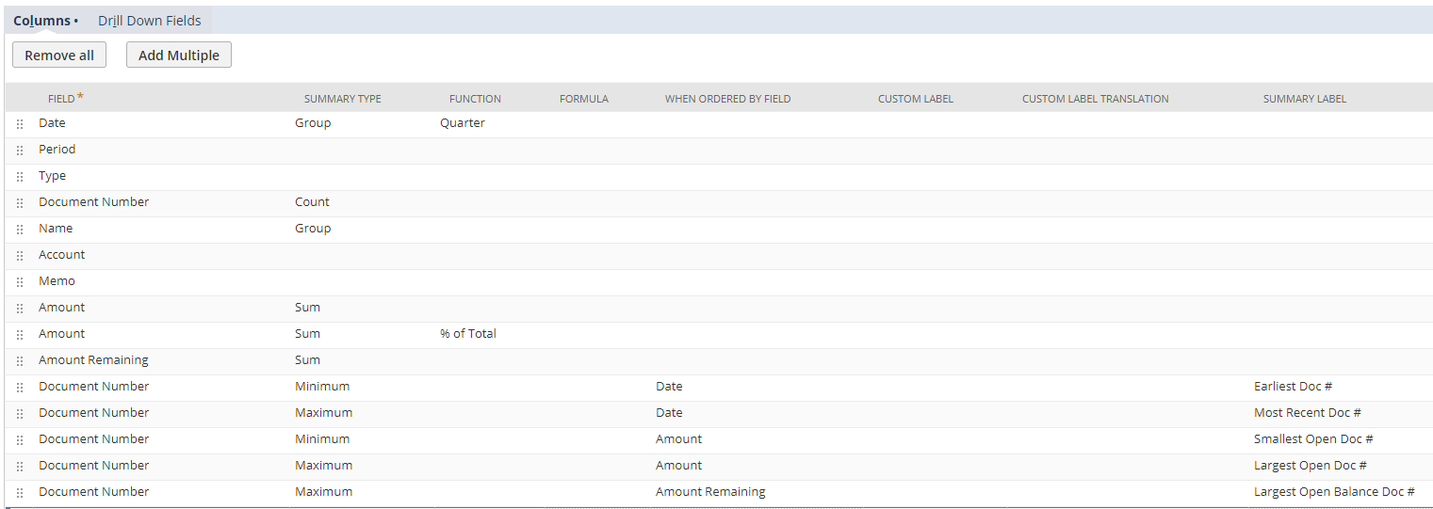
When Ordered By
The “When Ordered By” column is meant to work in tandem with summary types of “Minimum” and “Maximum”.

Slide 37
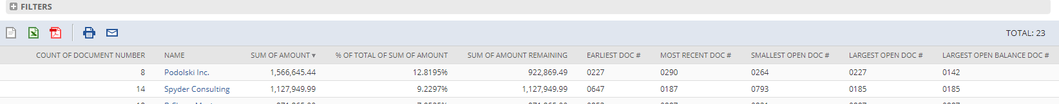
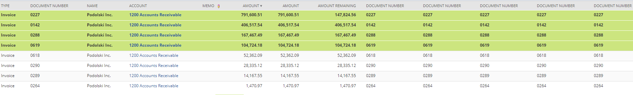
When Ordered By Sample Results
The “When Ordered By” returns a different Document # in each case for the 1st row.

Slide 38
Inline Editing
What is Inline Editing?
Enabling Inline Editing feature
General Restrictions
Shortcuts
Differences between Standard/Custom records, Items and Transactions
See an example of Inline Editing in action

Slide 39
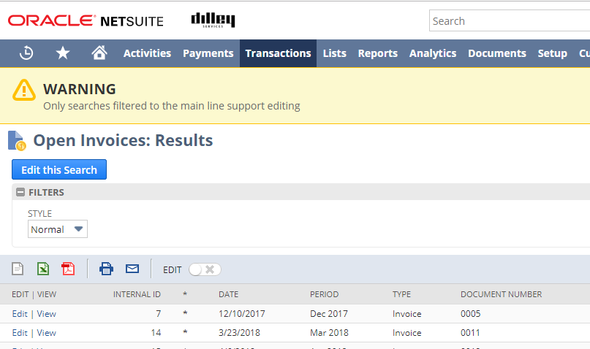
Inline Editing
Inline editing gives you the ability to edit certain fields on the records you’re searching directly in the search results – Allowing for much quicker data management

Slide 40
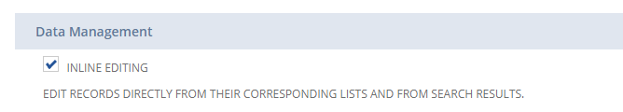
Enabling Inline Editing
Under Setup > Company > Enable Features > Data Management lies the Inline Editing feature checkbox.

Slide 41
Inline Editing Restrictions
The record must support inline Editing
The records Primary Form must have the field set to Normal
The field cannot be a referenced to by a formula custom field
The user must have the Edit permission on the for the record

Slide 42
Inline Editing Shortcuts
Here are some keyboard shortcuts for navigating Inline Editable fields
  Tab > Move Right
  Shift + Tab > Move Left
  Shift + Enter > Move Up
  Enter > Move Down
  Alt + X > Edit First Available Field
  Ctrl + Z > Undo previous edit
  Esc > Finished editing field
  Del > Deletes all selected records (Checks for dependencies)
Keyboard + Mouse Maneuvers (Like Excel)
  Ctrl + Click > Selects multiple records at a single time
  Shift + Click > Selects a range of records

Slide 43
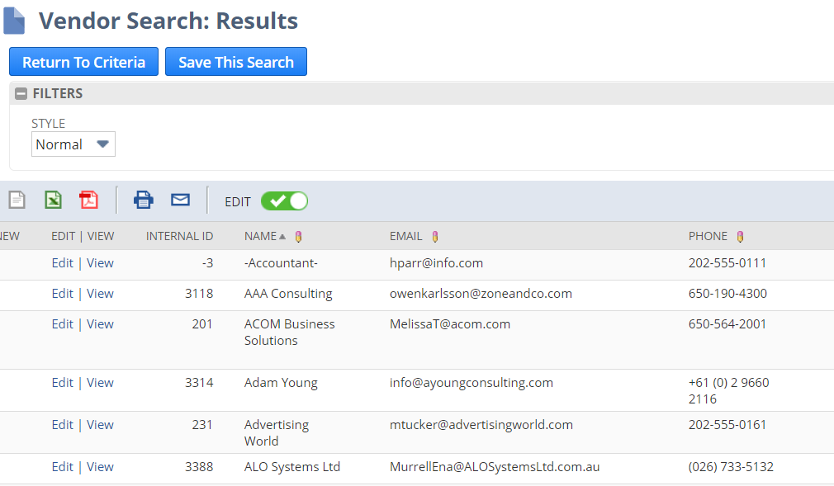
Inline Editing on a Standard Record
Inline Editing is available on most Standard records with few notable exceptions. (Subsidiary/Account to name a couple)

Slide 44
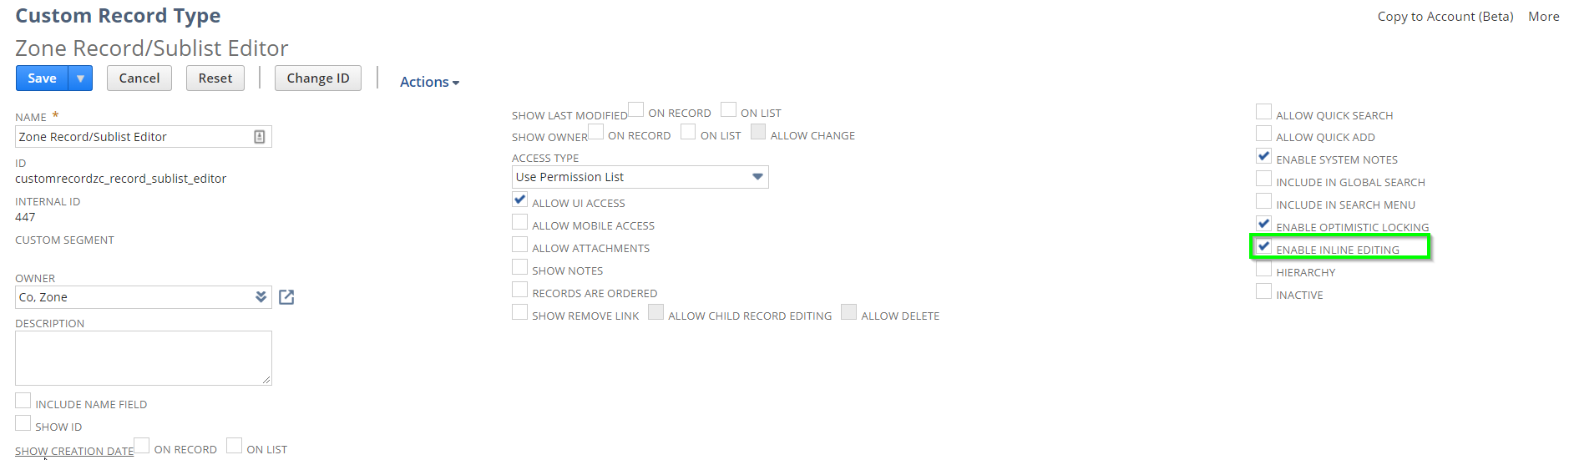
Inline Editing on a Custom Record
Inline Editing is feature exposed to each Custom record individually.

Slide 45
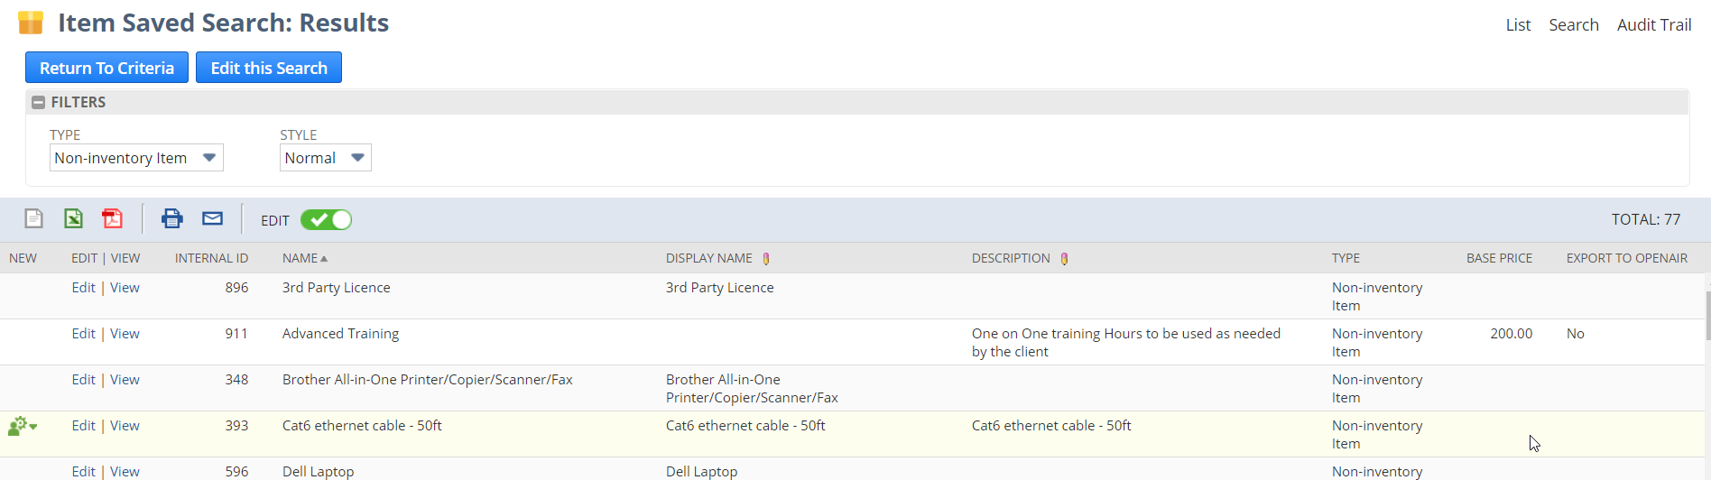
Inline Editing In Item Searches
An Item Search must be restricted to a Single “Type” to enable inline editing

Slide 46
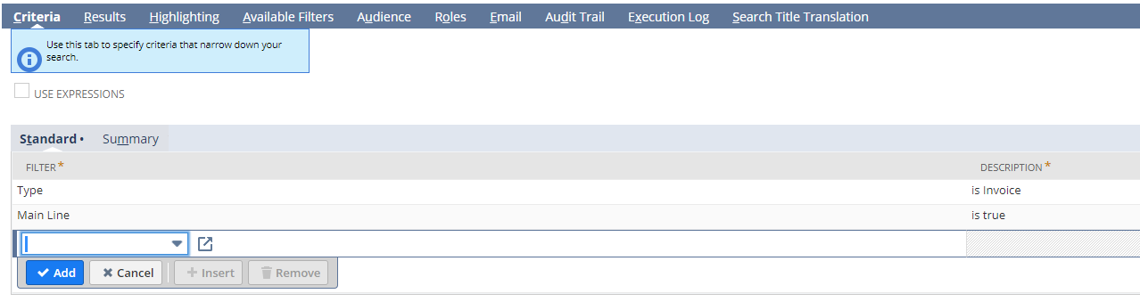
Inline Editing In Transaction Searches
A transaction search must have 2 specific criteria to allow “Inline Editing”
Type must be restricted to a single transaction type
Main Line must be set to true

Slide 47
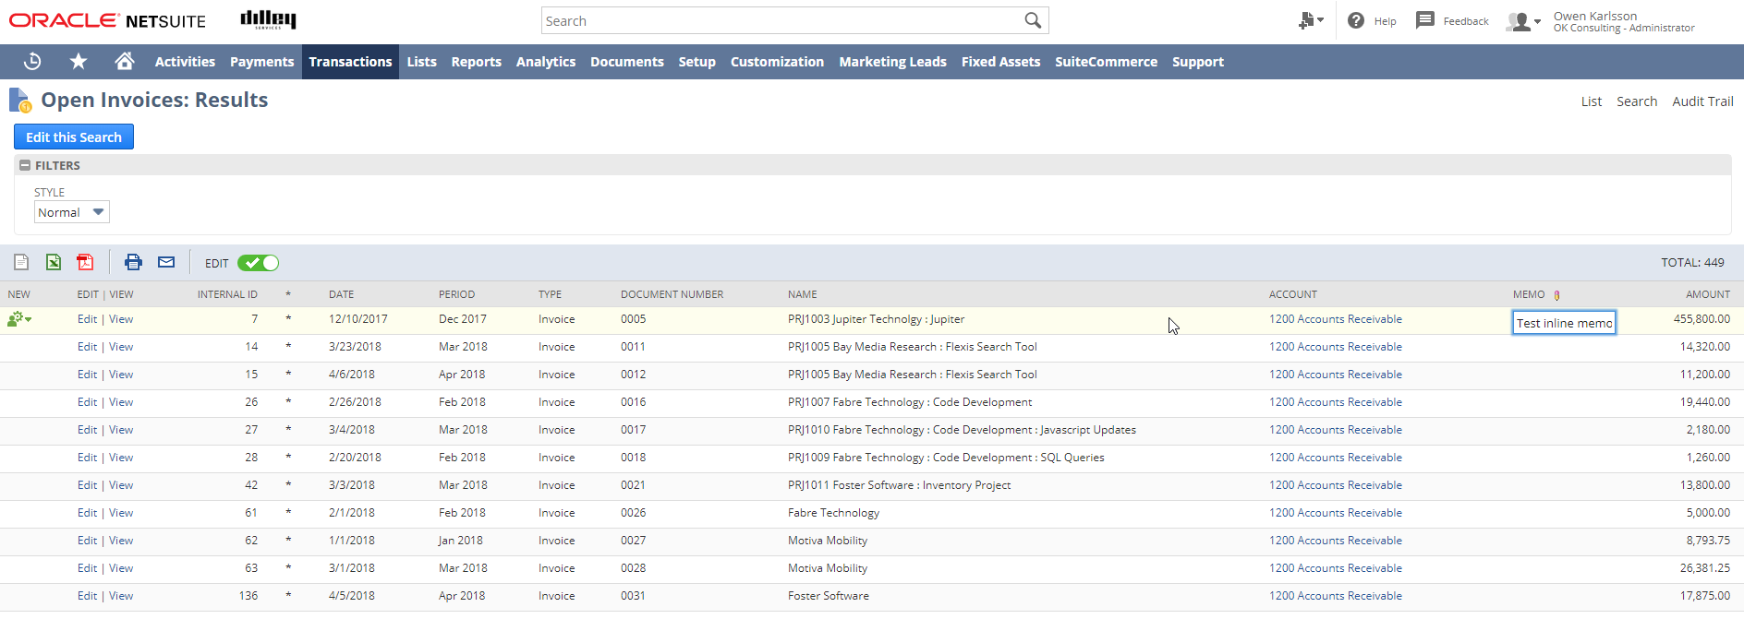
Inline Editing Example
Once filtered to a single transaction type and main line = true, you can enable the inline editing toggle
Fields that are inline editable will have a pencil icon next to the column name

Slide 48
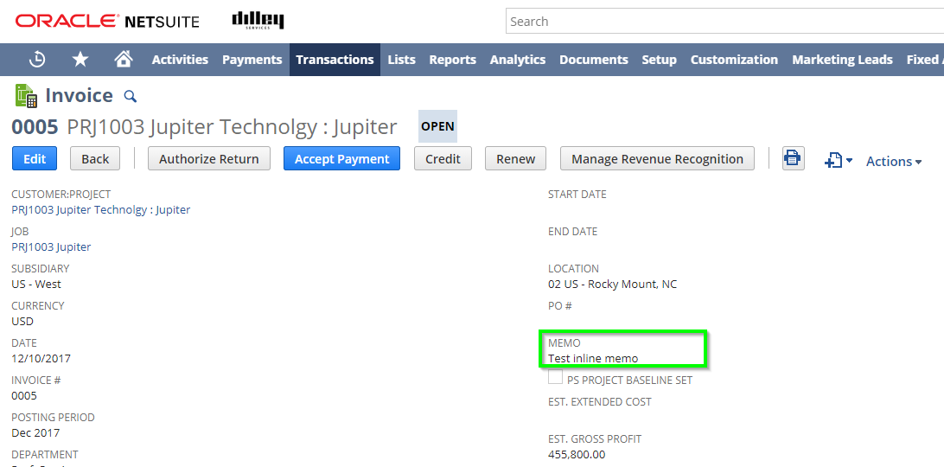
Sample Inline Editing Result
Note the field on the invoice has the value entered in the saved search results.

Slide 49
Formulas in Saved Search
Formula Types
  Currency, Date, Date/Time, Numeric, Percent & Text
SQL Conventions (Understanding the NetSuite canned formulas)
Common Formulas
  DECODE, CASE WHEN, SUBSTR, TO_CHAR, TO_DATE, TO_NUMBER, LAST_DAY, MONTHS_BETWEEN, CONCAT, NVL
Nested Formulas
Some other “Cool” formulas
Next Level Reporting, A look at a Multi-book “Recon” search
Going Even Further, Creating a Deferred Revenue Waterfall Search

Slide 50
Formula Types
Formula Types are important, they control what type of data the formula is expected to return
The incorrect Formula Type can result in an error
There are 3 “families” of Formula Types
  Numeric:
  Formula (Currency) – This will display like Excel displays numbers in “Currency” format (2 decimals)
  Formula (Numeric) – This will display like Excel displays numbers in “General” format
  Formula (Percent) – This will display like Excel displays numbers in “Percent” format
  Date:
  Formula (Date) – This will return a date.
  Formula (Date/Time) – This will return a date & time
  Text:
  Formula (Text) – This will return text.

Slide 51
Conventions in SQL
/app/help/helpcenter.nl?fid=section_N2833020.html
Convention | Meaning | Example
[ ] | Anything enclosed in brackets is optional. | LTRIM(char [ , set ])
{ } | Braces are used for grouping items. | TO_CHAR({ datetime | interval } [, fmt [, 'nlsparam' ] ])
| | A vertical bar represents a choice of two options. | ATAN2(n1 { , | / } n2)
... | An ellipsis mean repetition in syntax descriptions or an omission in code examples or text. | DECODE(expr, search, result [, search, result ]...[, default ])
UPPERCASE | Indicates an element supplied by the system. These terms are shown in uppercase to distinguish them from terms you define. Unless terms appear in brackets, enter them in the order and with the spelling shown. Because these terms are not case sensitive, you can use them in either UPPERCASE or lowercase. | TRIM([ { { LEADING | TRAILING | BOTH }[ trim_character ] | trim_character } FROM ] trim_source)
lowercase | Indicates user-defined programmatic elements, such as field names. Note that some programmatic elements use a mixture of UPPERCASE and lowercase. Enter these elements as shown. | NULLIF(expr1, expr2)

Slide 52
DECODE
Syntax:
DECODE(expr, search, result[, search, result ]...[, default ])
Description:
Compares expr to each search value one by one. If expr is equal to a search, the corresponding result is returned. If no match is found, default is returned.
Example:
DECODE({accounttype},’Accounts Receivable’,’A/R’,’Accounts Payable’,’A/P’,’Not A/R or A/P’)
Translation: If Account Type is ‘Accounts Receivable’ return ‘A/R’, if it’s ‘Accounts Payable’ return ‘A/P’, if none of those are true, return ‘Not A/R or A/P’

Slide 53
CASE WHEN
Syntax:
CASE { expr WHEN comparison_expr THEN return_expr [ WHEN comparison_expr THEN return_expr ]... | WHEN condition THEN return_expr [ WHEN condition THEN return_expr ]... } [ ELSE else_expr ] END
Description:
Returns a value based on one or more BOOLEAN conditions
Example:
CASE WHEN {accounttype} = ’Accounts Receivable’ THEN ’A/R’ WHEN {accounttype} = ’Accounts Payable’ THEN ’A/P’ ELSE ’Not A/R or A/P’ END
Translation: If Account Type is ‘Accounts Receivable’ return ‘A/R’, if Account Type is ‘Accounts Payable’ return ‘A/P’, if none of those are true, return ‘Not A/R or A/P’

Slide 54
SUBSTR
Syntax:
SUBSTR(char, position [, substring_length ])
Description:
lets you extract a sequence of characters that matches a regular expression pattern from the source string (source_char)
Example:
SUBSTR({postingperiod},1,3) >> ‘May 2020’ returns ‘May’
SUBSTR({postingperiod},5,4) >> ‘May 2020’ returns ‘2020’
Translation: Take the string (char), start at position, # of characters returned). This is similar to a MID() in Excel

Slide 55
TO_CHAR
Syntax:
TO_CHAR({ datetime | interval } [, fmt [, 'nlsparam' ] ])
Description:
converts a datetime or interval value to a value of VARCHAR2 datatype in the format specified by the date format fmt
Example:
TO_CHAR({date}, 'hh24')
Translation: This turns some Text into a Date/Time data type field in the specified format

Slide 56
TO_DATE
Syntax:
TO_DATE(char [, fmt [, 'nlsparam' ] ])
Description:
Converts a formatted TEXT or NTEXT expression to a DATETIME value
Example:
TO_DATE('31.12.2011', 'DD.MM.YYYY')
Translation: Converts text into a data type of Date

Slide 57
ADD_MONTHS
Syntax:
ADD_MONTHS(date, integer)
Description:
returns the date plus integer months
Example:
ADD_MONTHS({today},-1)
Translation: This returns a month before today’s date.

Slide 58
LAST_DAY
Syntax:
LAST_DAY(date)
Description:
Returns the date of the last day of the month that contains date
Example:
LAST_DAY({today})
Translation: Return the last day in the current month

Slide 59
MONTHS_BETWEEN
Syntax:
MONTHS_BETWEEN(date1, date2)
Description:
Returns the number of months between date1 and date2
Example:
MONTHS_BETWEEN(SYSDATE,{createddate})
Translation: This is the Months between the date created and the current system date
NOTE: SYSDATE is how your reference the CURRENT Date/Time according to the system

Slide 60
CONCAT
Syntax:
CONCAT(char1, char2)
Description:
Concatenates char1 and char2 into one string
Example:
CONCAT({number},CONCAT('_',{line}))
This is a “nested” concat, meaning the same formula appears within itself
Translation: Number_Line
Alternate Approach: Two pipes “||” also act as a concat like “&” in Excel
{number} || ‘_’ || {line} >> Returns the same result

Slide 61
NVL
Syntax:
NVL(expr1, expr2)
Description:
Allows you replace null with the second parameter
Example:
NVL({quantity},'0')
Translation: If Quantity is NULL then return 0, otherwise return Quantity

Slide 62
Nested Formulas (Expanded)
Creating a “nested” formula can be easy. Updating it later may be more difficult…
Start with a single formula, but leave room for a Place holder
DECODE({customer.status},’CLOSED-LOST’,’Ignore – Closed’,NEST_PLACEHOLDER)
Write another formula… CASE WHEN {customer.balance} < 10000 THEN ‘Transactional’ ELSE NEST_PLACEHOLDER END
Copy one formula and paste it over the “Nest_Placeholder”
DECODE({customer.status},’CLOSED-LOST’,’Ignore – Closed’, CASE WHEN {customer.balance} < 10000 THEN ‘Transactional’ ELSE NEST_PLACEHOLDER END)

Slide 63
Nested Formulas (Continued)
DECODE({customer.status},’CLOSED-LOST’,’Ignore – Closed’, CASE WHEN {customer.balance} < 10000 THEN ‘Transactional’ ELSE NEST_PLACEHOLDER END)
Continue to write more formulas until you’ve covered everything
CASE WHEN {amount} > 100000 AND MONTHS_BETWEEN({today},{duedate}) > 3 THEN ‘100k+ AND 90+days late’ ELSE ‘Uncategorized’ END
DECODE({customer.status},’CLOSED-LOST’,’Ignore – Closed’, CASE WHEN {customer.balance} < 10000 THEN ‘Transactional’ ELSE CASE WHEN {amount} > 100000 AND MONTHS_BETWEEN({today},{duedate}) > 3 THEN ‘100k+ AND 90+days late’ ELSE ‘Uncategorized’ END END)

Slide 64
Cleaning up a bad example…
BEFORE
DECODE({customer.status},’CLOSED-LOST’,’Ignore – Closed’, CASE WHEN {customer.balance} < 10000 THEN ‘Transactional’ ELSE CASE WHEN {amount} > 100000 AND MONTHS_BETWEEN({today},{duedate}) > 3 THEN ‘100k+ AND 90+days late’ ELSE ‘Uncategorized’ END END)
AFTER
CASE WHEN {customer.status} = ’CLOSED-LOST’ THEN ’Ignore – Closed’ WHEN {customer.balance} < 10000 THEN ‘Transactional’ WHEN {amount} > 100000 AND MONTHS_BETWEEN({today},{duedate}) > 3 THEN ‘100k+ AND 90+days late’ ELSE ‘Uncategorized’ END
DIFFERENCE
A single CASE statement with multiple WHEN/THEN conditions is easier to read

Slide 65
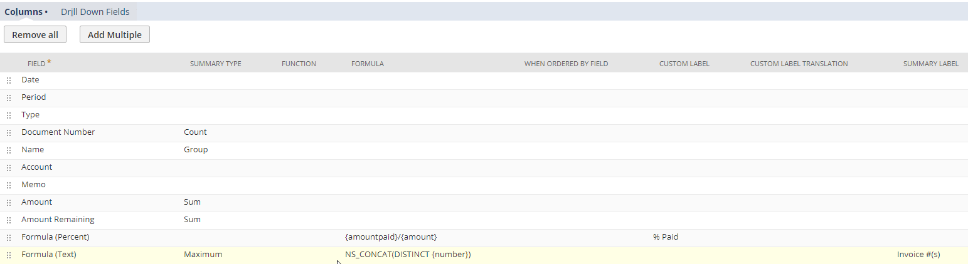
Some other “cool” formulas
NS_CONCAT (DISTINCT expr)
  This only works in Summary Results and requires a Minimum or Maximum
  This returns a comma separated list of unique values in the Group

Slide 66
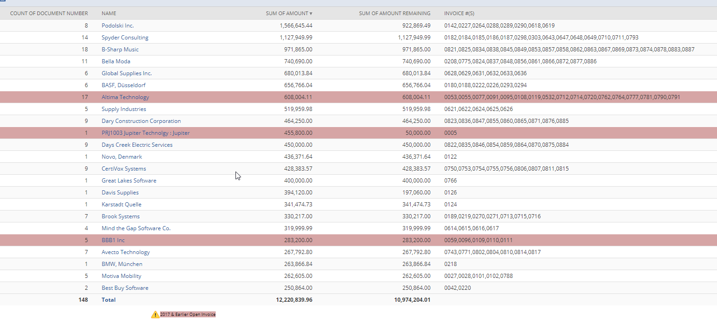
NS_CONCAT(DISTINCT expr) Example

Slide 67
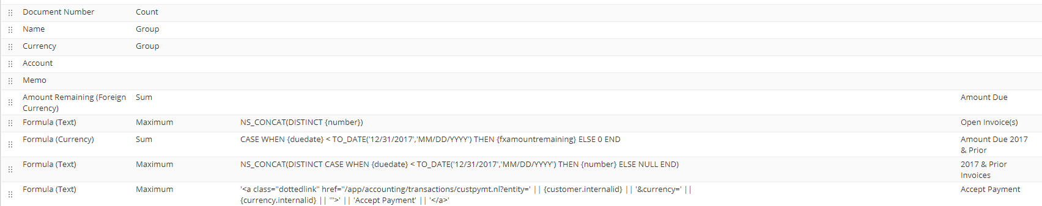
HTML Formulas (with dynamic links)
You can write HTML in any “Formula (Text)” result
You can also leverage fields from the results to create dynamic links
The below example is a Clickable Link on each row which will take you to the “Accept Payments” Screen for that Customer & Currency combination
'<a class="dottedlink" href="/app/accounting/transactions/custpymt.nl?entity=' || {customer.internalid} || '&currency=' || {currency.internalid} || '">' || 'Accept Payment' || '</a>'

Slide 68
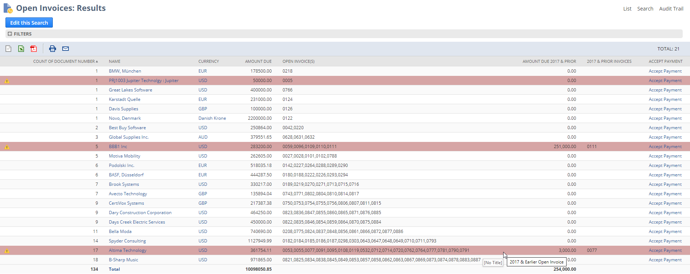
HTML Formula Results

Slide 69
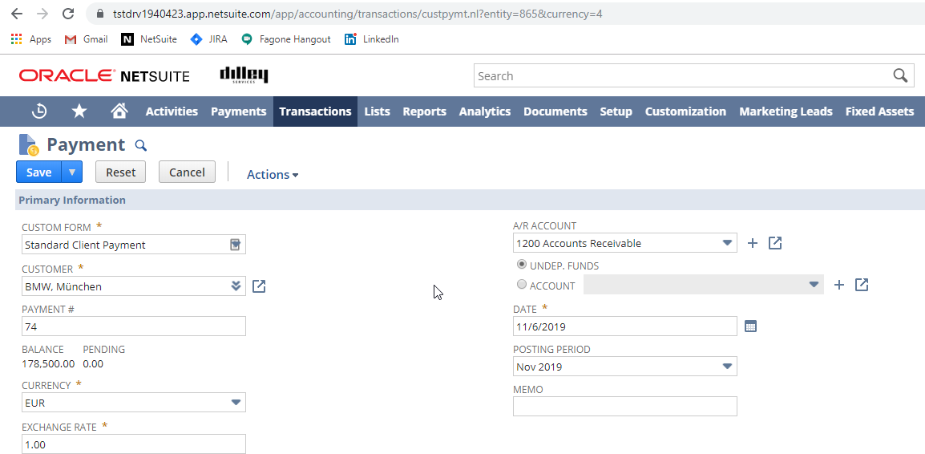
Sample Payment Link
Notice is fills in both the appropriate Customer and Currency in the URL

Slide 70
Next Level Recons…
The next example is a Revenue Element Search in a Multi-book environment meant to give a side-by-side comparison of Primary Book and Secondary Book Elements & Plans
The groupings are all done at the Source Transaction Level (Sales Order/RMA etc.)
“Book Specific” Formulas were written to add more “Width” to the search results instead of “Depth”
Reconciling Formulas were created with a simple “Multiplier” concept (Primary = Positive, Secondary = Negative)

Slide 71
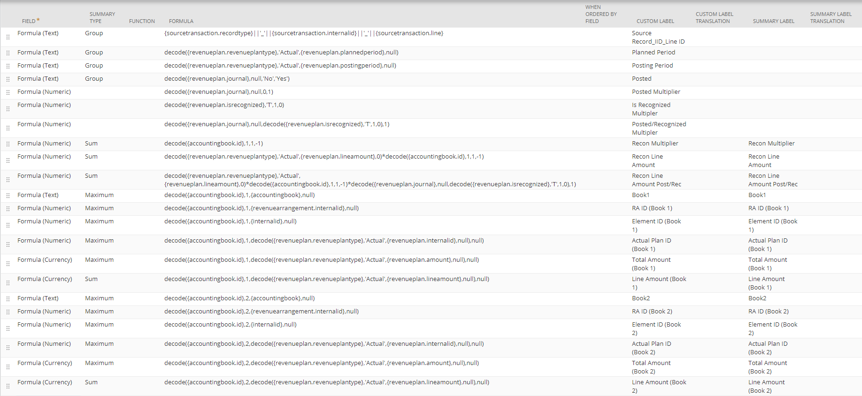
Multi-book Rev Element & Plan Recon Example
TEXT

Slide 72
Revenue Waterfalls in Saved Search?
Depending on what the user is looking for, this is possible in saved search. The key is to convert the Period into a date and compare that to another date. In the next example, we are doing a few different things. Like many formulas, there are many ways to accomplish this, here’s just one example
Check to see if revenue is posted (if yes, take posting period, else, planned period)
“BLENDED_PERIOD” = decode({revenueplan.postingperiod},null,{revenueplan.plannedperiod},{revenueplan.postingperiod}
Concat ’01 ’ with “BLENDED_PERIOD” to make a string like ‘01 Mmm YYYY’
“BLENDED_PERIOD_DATE_(TEXT)” = CONCAT('01 ‘,BLENDED PERIOD)
Convert “BLENDED_PERIOD_DATE_(TEXT)” into a date value/datatype
“BLENDED_PERIOD_DATE” = TO_DATE(“BLENDED PERIOD DATE (TEXT)”,’DD MM YYYY’)
Convert Today’s date into the First of the month (to avoid rounding issues later)
“FIRST_OF_THE_MONTH” = TRUNC({today},'MM’)
Find the Months Between the BLENDED PERIOD DATE and FIRST OF THE MONTH
“PERIOD_MONTHS_FROM_TODAY” = MONTHS_BETWEEN(“BLENDED_PERIOD_DATE”, “FIRST_OF_THE_MONTH”)

Slide 73
Revenue Waterfalls in Saved Search (Cont’d)
Here’s what we have so far…
“BLENDED_PERIOD” = decode({revenueplan.postingperiod},null,{revenueplan.plannedperiod},{revenueplan.postingperiod}
“BLENDED_PERIOD_DATE_(TEXT)” = CONCAT('01 ‘,BLENDED PERIOD)
“BLENDED_PERIOD_DATE” = TO_DATE(“BLENDED_PERIOD_DATE_(TEXT)”,’DD MM YYYY’)
“FIRST_OF_THE_MONTH” = TRUNC({today},'MM’)
“PERIOD_MONTHS_FROM_TODAY” = MONTHS_BETWEEN(“BLENDED_PERIOD_DATE”, “FIRST_OF_THE_MONTH”)
We want to make sure we only return amounts for ‘Actual’ Plans in this case
“ACTUAL PLAN AMOUNT” = decode({revenueplan.revenueplantype},'Actual',{revenueplan.lineamount},0)
Finally, we compare PERIOD MONTHS FROM TODAY=0 (for Revenue Posted/Planned this month)
“ACTUAL_AMT_THIS_MONTH” = decode(PERIOD_MONTHS_FROM_TODAY,0,ACTUAL_PLAN_AMOUNT,0)
And when we actually put that all together, we get something like this:
decode(MONTHS_BETWEEN(TO_DATE(CONCAT('01',decode({revenueplan.postingperiod},null,{revenueplan.plannedperiod},{revenueplan.postingperiod})),'DD MM YYYY’), TRUNC({today},'MM')),0,decode({revenueplan.revenueplantype},'Actual',{revenueplan.lineamount},0),0)
Once this formula is written and tested, from here, if you change the highlighted 0 to a different number, you will get a different month relative to Today’s date.

Slide 74
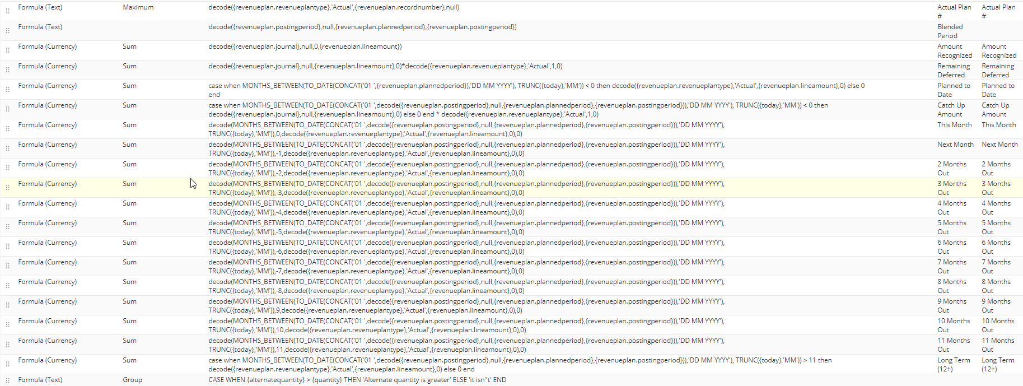
Saved Search Revenue Waterfalls (Completed)

Slide 75
THANK YOU!

Slide 76
Financial Discussion Panel
Presented by: Joe Cockriel, Christina Mendonca & Matt Sansone

Slide 77
Oracle PBCS (EPM Planning)
Implemented in 2017
Employee level Workforce planning
Financial Statements and management reporting
Budget vs Actuals
Rolling Multi-Year Plan
Heavy Excel SmartSheet user base
No requirement to use the drill through or meta data import yet
Continuously evaluating how to automate assumptions and uploads in additional into the EPM suite

Slide 78

Solution 7: Saving Time & Headaches
Avid Solution 7 user since 2017. Use in a variety of ways that alleviate exporting pain points
  Month end close
  Financial Statements
    Balance Sheet
    Income Statement
    CashFlow
    Budget vs Actual (by dept & in total)
  Auditors
    TB by Sub (in local currency), Dept, and year
  KPIs
  Budgeting

Slide 79
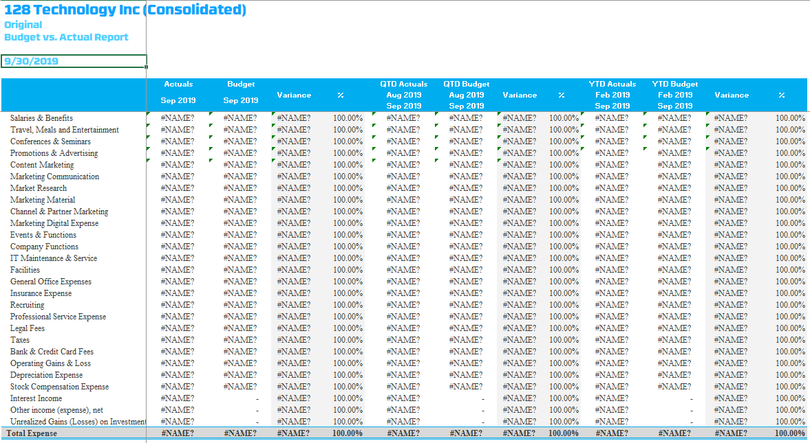
Income Statement & Budget

Slide 80
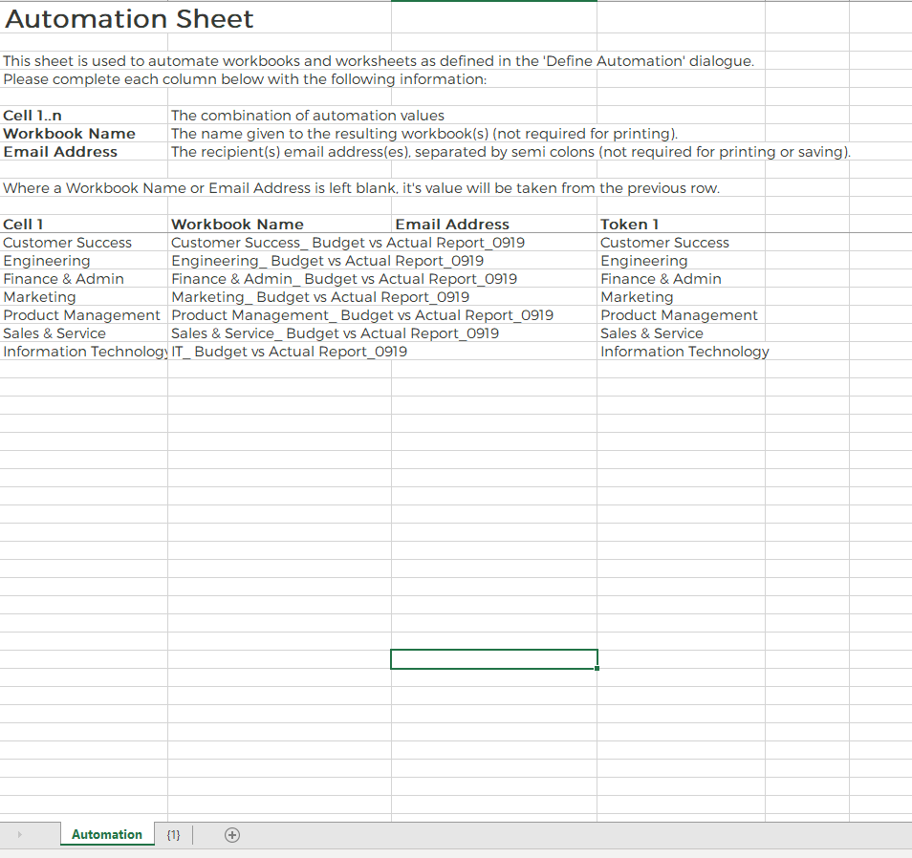
BvA by Department Automation

Slide 81
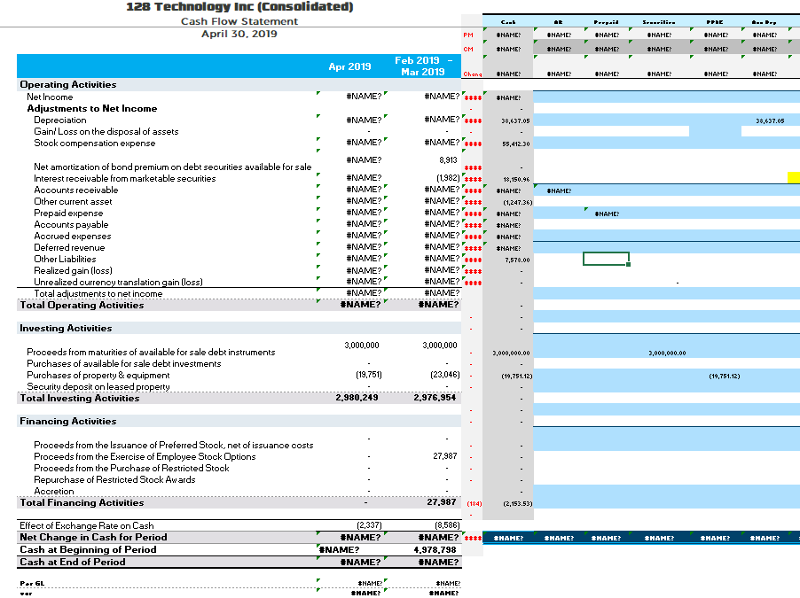
Cash Flow

Slide 82
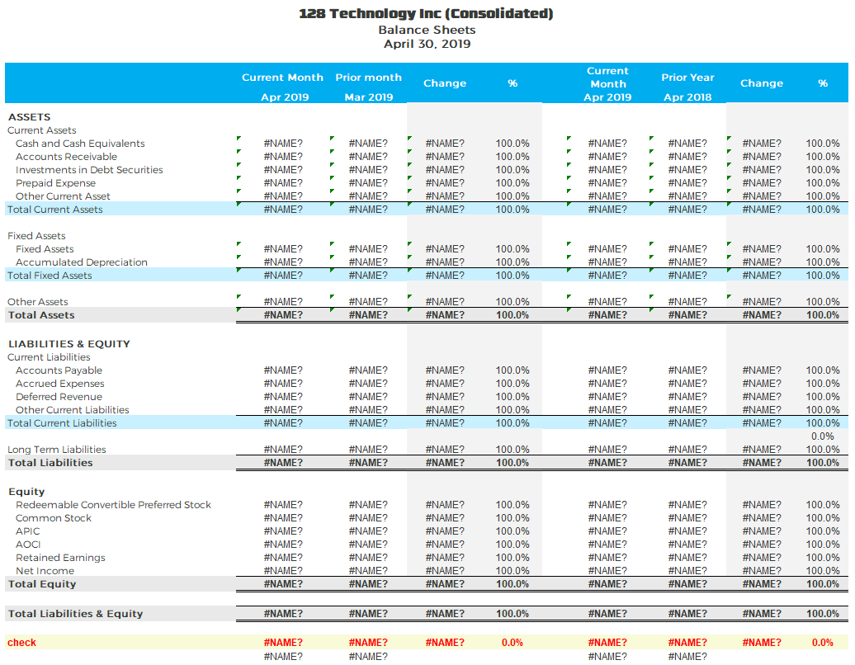
Balance Sheet

Slide 83
NetSuite Year End Close
Matt Sansone

Slide 84
Agenda
Accounting Period Setup
NetSuite Period Close
Period Close Best Practices
Additional Features & Settings

Slide 85
Accounting Period Setup
Period Creation
  Setup Full Year
    Period Formats: Calendar Months, 4 Weeks, 4-4-5 Weeks
    Adjusting Period
  New Year, Quarter or Base Period only
Allow Non-G/L Changes
  Per Period, by editing after periods are closed
  Per Role, by adding Allow Non G/L Changes permission (Setup)
Setup > Accounting > Manage Accounting Periods

Slide 86
NetSuite Period Close: Basics
Period Status: Unlocked vs. Locked vs. Closed
  Unlocked: any user can post transactions
  Locked: only users with the Override Period Restrictions permission (Setup) can edit or create transactions
  Closed: no users, including Administrators, can post or make changes to transactions.
Close All Prior Periods
  All prior periods must be closed in order to close the current period.
  All prior periods do not have to be closed in order to lock the current period.

Slide 87
NetSuite Period Close: Basics Cont.
Reopening a Period
  Periods previously closed can be reopened if adjustments are needed.
  Reopening a period will open any subsequent periods.
Audit Trail
  System notes are tracked on each task of the Period Close checklist.
  Justification is required to reopen a closed period and is tracked within the system notes.
  Saved Search Audit Trail/System Notes

Slide 88
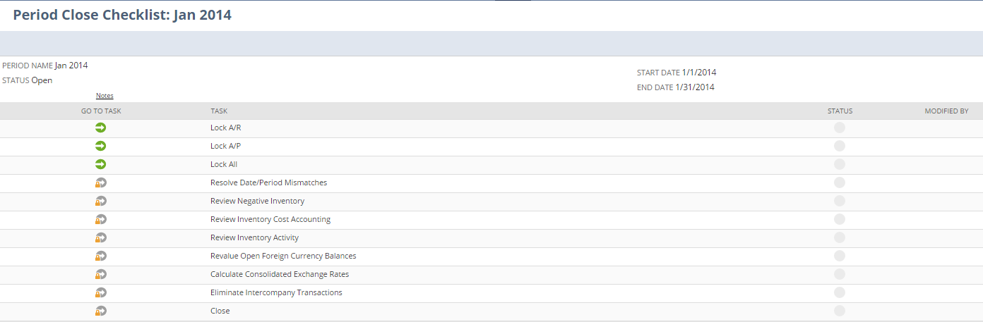
NetSuite Period Close: Checklist
Depending on the features enabled in each account, the following tasks may be available:
  Review Inventory Activity
  Create Intercompany Adjustments
  Calculate Consolidated Exchange Rates
  Eliminate Intercompany Transactions
  Resolve Date/Period Mismatch – Inventory transactions
  Review Negative Inventory
  Review Inventory Cost Accounting
  Revaluate Open Foreign Currency Balances
  GL Audit Numbering

Slide 89
Period Close Best Practices
Automatic vs. Manual Close
  Automatic close: NetSuite calculates prior net income into retained earnings automatically. This option is best practice.
Non-NetSuite Tasks
  NetSuite requires specific tasks to be completed. Other company-specific tasks are also likely required outside NetSuite. Clients should track all of these tasks in one place.

Slide 90
Period Close Best Practices Cont.
Complete Tasks Before Using Checklist
  Some tasks in the Period Close Checklist require action that can be completed independent of the checklist such as:
    Review Negative Inventory
    Revalue Open Foreign Currency Balances
Role Permissions & Adjustment Periods
  NetSuite best practice recommends using role permissions to control who can post to locked periods rather than creating adjustment periods, where possible.
  Adjustment periods create an additional timeframe in which journal entries can be posted. For example, an adjustment period could be added on 12/31 for any year-end adjusting entries that should not be directly attributable to the Dec 2013 period.

Slide 91
Additional Features & Settings
Multiple Calendars in OneWorld
Multi – Book enablement features
GL Audit Numbering
Accounting Period Window setting

Slide 92

NetSuite Tip Corner
NS TIP
Presented by: Christopher Manchester
CORNER

Slide 93
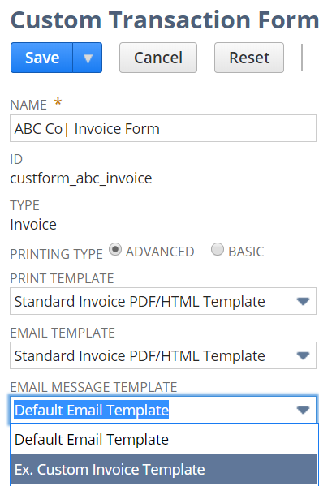
Tips & Tricks
Associate Custom Email Templates with Custom Transaction Forms
Customization > Forms > Transaction Forms
Select a transaction form to edit/customize
New ‘Email Message Template’ dropdown

Slide 94
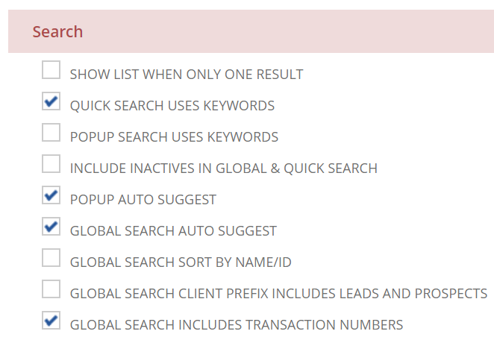
Tips & Tricks
Preference to Include or Exclude Transaction Numbers in Global Search
Role: and user-level preference
Role: Preferences subtab on custom role
User: Home > Set Preferences > Analytics > Search

Slide 95
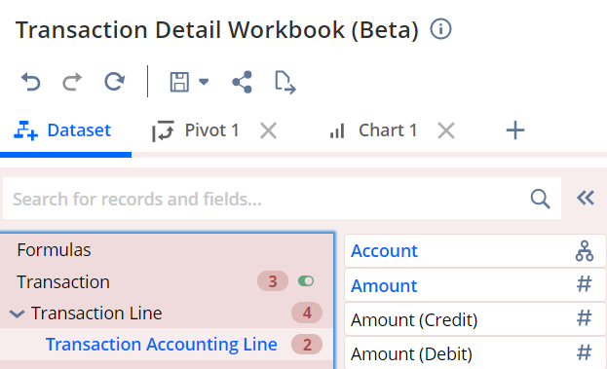
Tips & Tricks
Explore Transaction Details in New Transaction Detail Workbook (Beta)
Same information as Transaction Details report
Template for joining information from transaction header, line and accounting lines
Full capabilities of SuiteAnalytics Workbook tool
  Multi-Level Joins, Pivoting, Charting

Slide 96
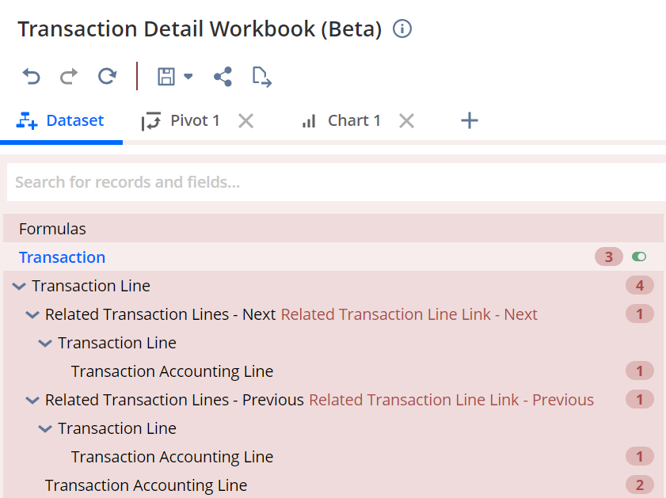
Tips & Tricks
Join Previous and Next Transactions in Transaction Detail Workbook (Beta)
Sales Order <> Invoice <> Customer Payment
Purchase Order <> Vendor Bill <> Bill Payment
Further record joins, pivoting, charting

Slide 97
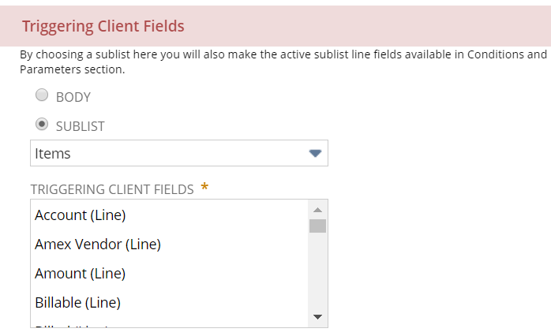
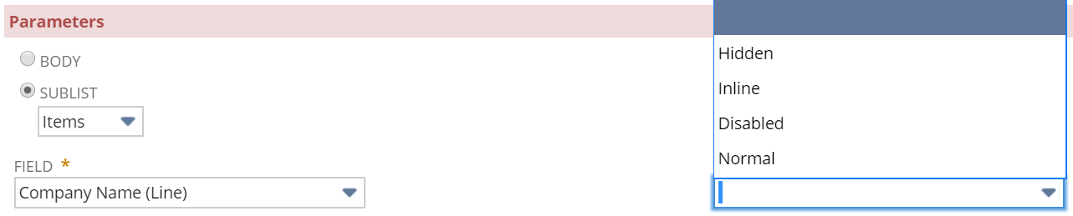
Tips & Tricks
New Support for Workflow Actions to Execute on Items Sublist
Set Field Value, Return User Error
Set Field Display Type, Set Field Value, Return User Error
  Some limitations on triggers
Set Field Display Type

Slide 98
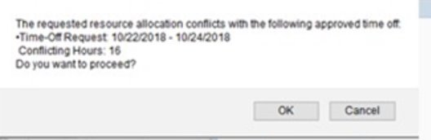
Tips & Tricks
Enhancements to Resource Allocation Charts/Grids
  Custom Segment Support
    Ability to filter Resource Allocation Charts by custom segments applied to employees, vendors, and other resources.
Time Off Integration
  Gives Resource Managers information on conflicting dates and times for employee resources.

Slide 99

Tips & Tricks
  Set up one feature across multiple subsidiaries
  Setup one subsidiary across multiple features
  Setup multiple features across multiple subsidiaries
Subsidiary Settings Manager
  Accessed via Setup > Company > Subsidiary Settings Manager
  Limitation: Period-End Journal Entries are the only feature supported in 2019.2

Slide 100


Tips & Tricks
Updates to G/L Impact Printing
  Enhancements to G/L Impact formatting
  Ability to print G/L Impact data in bulk from the ‘Print Checks and Forms’ page

Slide 101

Tips & Tricks
Enhancements to Memorized Transactions
  New Record for Memorized Transactions
  All previous records will be migrated to new form
  Custom Date tab added for more defined dates

Slide 102


Tips & Tricks
Advanced Banking Data Import
Import more file formats from more financial institutions
Direct Bank Connectivity
Asynchronous Importing
Ability to Exclude Bank Account Transaction Type Codes
More Informative Import Status and Results

Slide 103





Tips & Tricks
Open Sandbox in Same Browser as Production
Log in to the production account Select another role in a sandbox account Ctrl + click to open in another tab Select the original tab with your production role, and click Login | Bonus. The same methodology works for 3 or more accounts and is not limited to sandbox

Slide 104



Tips & Tricks
Delete Multiple Records at Once from List/Search
1.
2.
3.
Turn on Inline Editing
Select the first line to delete
  Hold shift and select the last line to delete
Hover over the ‘New’ field
  This column appears when inline editing is on
Select ‘Delete Record’
4.

Slide 105

Tips & Tricks
Sort Sublists Based on Multiple Criteria
1.
2.
Example: Sorting list of bills to pay by vendor and due date
On the Bill Payments screen, hold shift and select the ‘Due Date’ header
Hold shift and select the ‘Vendor’ header
  The sublist will now be sorted by Vendor, then by due date.

Slide 106

Tips & Tricks
Change the Color Scheme in NetSuite
Navigate to Home > Set Preferences > Appearance subtab Choose the desired color scheme based on the dropdown Select the original tab with your production role, and click Login

Slide 107

Tips & Tricks
SuiteBuilder –Field Formatting
Introducing nsformat_*() methods in FreeMarker Number, date, time, currency formats aligned Less hardcoding

Slide 108

Tips & Tricks
Project Budgets/WBS – NEW WBS interface

Slide 109

Tips & Tricks
SUITEBUILDER – Link to objects /images in file cabinet

Slide 110

Tips & Tricks
SUITEBUILDER – Direct template Access to address sub-records
Currently “subsidiary_addresstext” appears as a block Now each address field is available Add or remove certain fields

Slide 111

Tips & Tricks
Vendor Prepayments
Easy, consistent way to record and pay vendor deposits Easy to determine how many outstanding vendor deposits there are and their aging Specialized items on POs are covered Setup>Company>Enable Features>Accounting Subtab>Advanced Features Section> Vendor Prepayments Must also have a default vendor prepayment account assigned under Setup>Accounting>Accounting Preferences>General Subtab>Accounts Payable Section Does not yet support workflow for approval routing or advance PDF printing

Slide 112

Tips & Tricks
Time Modification – Bulk Modification

Slide 113

Tips & Tricks
Entity Merge Across Subsidiaries
Utilization of merge across Multi-Sub customers and vendors Look for Duplicates across Subsidiaries Support for Represents Subsidiary merge as well Merge multi-sub individual entities – merge customer and contact Master record assumed all transactions, messages, files ext. from original

Slide 114
Thank You!
Meet the Board
Mike Kean – Sikich
Stephen Enfield – POS Supply
Ken Phu – Hub Pen Company
Joe Cockriel – LogMeIn
Sean Murphy – Walton Signage
Non-Board Assistance
Lindsey White – Sikich
Elizabeth Keefe – Sikich
Bernard Enciso – Square Works Consulting
Chris Manchester – Sikich
Caroline Kirby-Madden – Zone & Co.
Presenters
Paul Giese – intheBlk Consulting
Gary Cifatte – Candy.com
Joe Smith – Candy.com
Kristen Balash – FSG
Keith Cruickshank
Jill Quintiliani - AppsAssociates
Owen Karlsson – Zone & Co.
Christina Mendonca – 128 Technology
Joe Cockriel – LogMeIn
Matt Sansone – RSM
Christopher Manchester – Sikich

Slide 115
Closing Remarks
Recap of Event
Next Meetings (tentative)
  Thursday, March 12, 2020
  SuiteWorld20: April 20-23rd
Please complete your evaluation form and leave at your seat
Questions, Initial Feedback and Suggestions for Next Meeting Topics and Presenters

Slide 116
Thank you to our Sponsors!

Slide 117
Thank You!
PLEASE LEAVE YOUR EVALUATIONS AT YOUR SEAT

